Slide 1
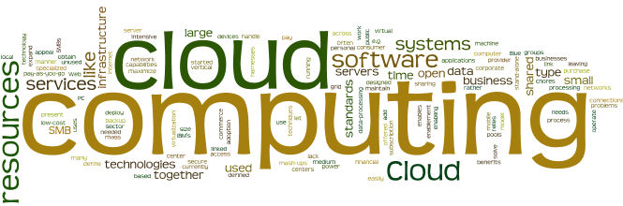
Virtualization Essentials

Slide 2
Module Objectives
You should able to answer below questions end of this module.
What is virtualization ?
How the virtualization works ?
Difference between traditional and virtual Architecture
Benefit of virtualization in IT and Cloud environment
Notes:
Virtualization is an evolving technology in the IT world. Virtualization is being used by a growing number of organizations to consolidate their workloads, to make their IT environments scalable and more flexible.

Slide 3
What is Virtualization ?
In computing, virtualization or virtualisation is the act of creating a virtual (rather than actual) version of something at the same abstraction level, including virtual computer hardware platforms, storage devices, and computer network resources. ( Wiki)
Create a software-based—or virtual—representation of applications, servers, storage and networks to reduce IT expenses while boosting efficiency and agility. (vmware)
Notes:
Virtualization is an evolving technology in the IT world. Virtualization is being used by a growing number of organizations to consolidate their workloads, to make their IT environments scalable and more flexible.

Slide 4
What is Virtualization ? (Continued)
Virtualization in computing often refers to the abstraction of some physical component into a logical object.
By virtualizing an object, you can obtain some greater measure of utility from the resource the object provides.
Improved manageability by being separated from the physical hardware.
The physical devices into logical objects that can be quickly and easily manipulated.
Notes:
In computing, virtualization is the creation of a virtual (rather than actual) version of a resource or device, like a server, an operating system, a storage device or network. Virtualization easily provides high availability for critical applications as well as streamlines application deployment & migrations.

Slide 5
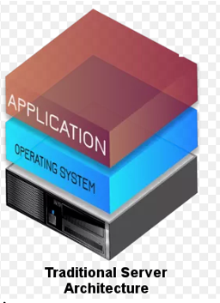
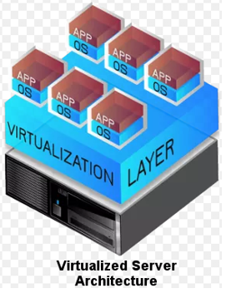
Difference Between Traditional and Virtual Architecture
Single OS image per machine
Underutilized resources
Hardware and Software tightly coupled as well as Inflexible and costly infrastructure
Running multiple applications on same machine often creates conflict
Hardware independence of applications and OS
Virtual machines (VMs) can be provisioned to any system
Can manage OS as well as application as a single unit by encapsulating them into virtual machines (VMs)

Slide 6
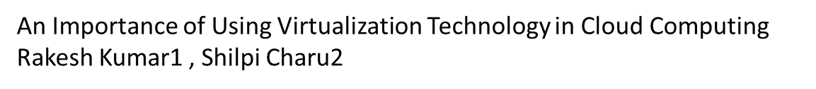
Importance of the Virtualization in Cloud Computing
Virtualization abstracts compute resources ,decouples users from implementation
Virtualization enables rapid scaling of resources
Cloud computing can exist without Virtualization, although it will be inefficient and difficult
Cloud computing makes notion of Pay for what you use, infinite availability
These notions are practical only if we have flexibility as well as efficiency in the back end
This efficiency is readily available in Virtualized Environments as well as Machines

Slide 7
Virtualization Benefits
There are many effective reasons to take into account as to why you would want to use virtualization technology:
Saves money
Resource optimization
Decreased power consumption and Data center consolidation
Reduces system administration work
Management is simplified
Maximizing Uptime
Software installation easier and price and licensing may effect
Increased CPU utilization from 5-15% to 60-80%
Better use from hardware
Good for the environment
Virtual machine can run on any x86 server

Slide 8
Module Summary
Virtualization is certainly a necessary tool, but it is more than that—it changes how you think, and out of that, companies find ways to innovate. Such as consolidating multiple application workloads on fewer physical hosts can immediately reduce costs and enable greater efficiency.
The change of mindset that virtualization makes the technology truly transformative. Virtualization is first step to enabling cloud-based services.

